Slide 1
PAT tools enabling control strategy of CQAs / Regulatory Updates
PPAR Annual Meeting 2011

Slide 2
ICH Q8 Control Strategy Definition (1)

Slide 3
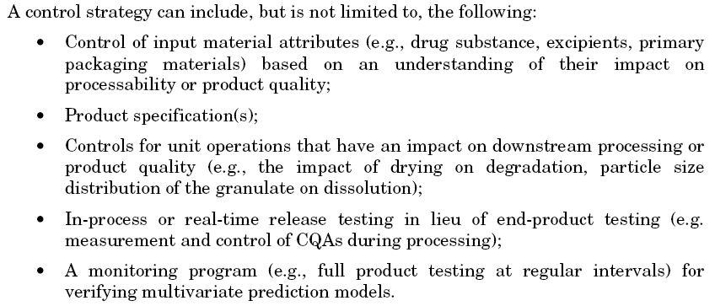
ICH Q8 Control Strategy Definition (2)

Slide 4
Regulatory updates
PAT control tools mentioned in the new FDA Process Validation Guideline (January 2011)
Control Strategy section in the ICH Points to Consider / ICH-Endorsed Guide for ICHQ9/Q9/Q10 Implementation (June 2011)
ASTM standards?
EMA and PQRI working groups on Large Sample Size statistical evaluations -> Separate discussion
Impact of EMA/FDA QbD Pilot Program on evaluation of PAT tools?
Anything else?

Slide 5
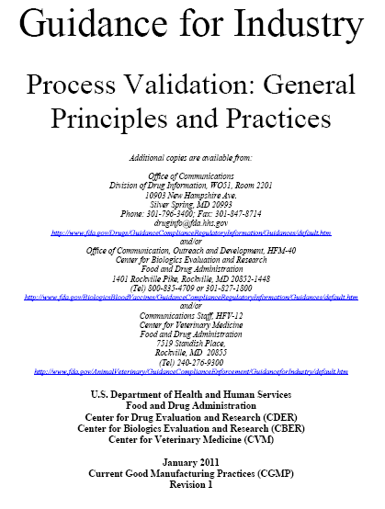
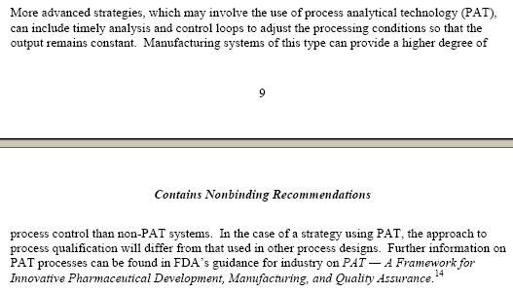
Ref. 1: FDA Validation Guideline (Jan 2011)
Section B-2 (bottom page 9 / page 10)

Slide 6
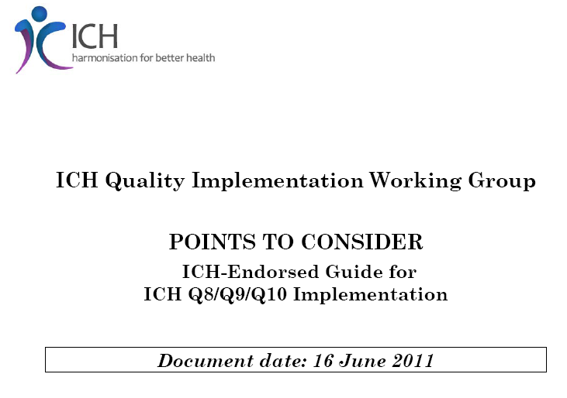
Ref. 2: ICH Doc. “Points to Consider” (Jun 2011)

Slide 7
Discussion topics
What is the importance of using PAT tools in developing a control strategy for a pharma process / CQAs in your company?
Do you use PAT tools for feed-forward/-back control loops?
What is the role of PAT tools to achieve RTRT for CQAs?
Do you have first-hand experience with registration of PAT solution(s) for Control Strategy?
From a regulatory point of view, are PAT control strategies treated in the same way in EU, US and Rest of World?

Slide 8
Back-ups

Slide 9
Ref. 2: ICH Doc. “Points to Consider” (Jun 2011)

Slide 10
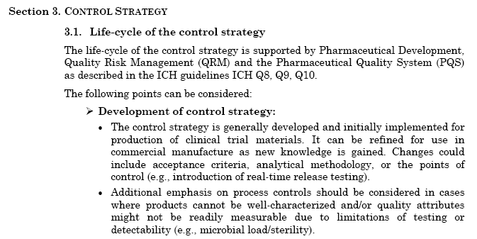
Ref. 2: ICH Doc. “Points to Consider” (Jun 2011)

Slide 11
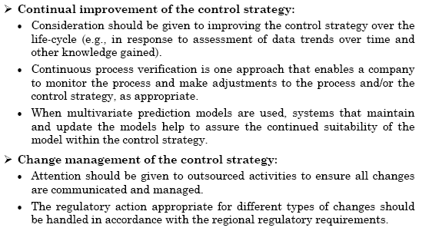
Ref. 2: ICH Doc. “Points to Consider” (Jun 2011)

Slide 12
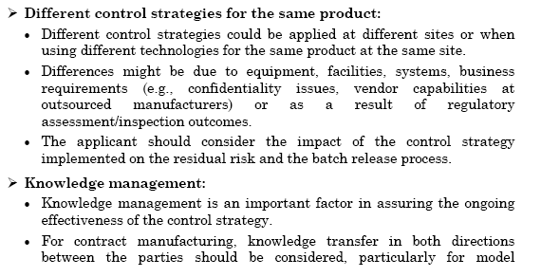
Ref. 2: ICH Doc. “Points to Consider” (Jun 2011)

Slide 13
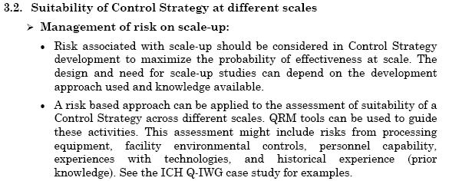
Ref. 2: ICH Doc. “Points to Consider” (Jun 2011)

Slide 14
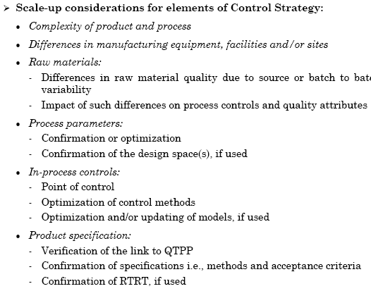
Ref. 2: ICH Doc. “Points to Consider” (Jun 2011)

